Slide 1
Unit 201: Health and safety in building services engineering
Dealing with hazards

Slide 2
Hazardous substances
Hazardous substances include the following:
adhesives
solvents
lubricants
jointing compounds
cleaning agents.

Slide 3
Hazardous substances
Precautions that should be taken to minimise the risk from hazardous substances include:
PPE
ventilation
risk assessment
Method Statements
safe systems of work.

Slide 4
Adhesives
Adhesives generally give off hazardous and harmful fumes.
For example, the PVC adhesive used to join PVC conduit and accessories can be very dangerous when used in poorly ventilated areas with the possibly of unconsciousness.
The adhesive can also cause serious health problems if ingested or if it gets on to the skin.

Slide 5
Solvents
A solvent is a substance that dissolves a chemically different liquid, solid or gas, resulting in a solution.
A solvent is usually a liquid but can also be a solid or a gas.
Common uses for solvents are in:
dry cleaning fluid
paint thinners
nail polish removers and glue solvents
spot removers
detergents
perfumes
nail polish.

Slide 6
Solvents
There are a number of hazards associated with solvents, including:
normally flammable or highly flammable
some can be explosive
toxic
the fumes can cause unconsciousness and death
some are carcinogenic
can have environmental effects.

Slide 7
Solvents
Here are some general precautions.
Avoid being exposed to solvent vapours by working in a fume hood or with local exhaust ventilation (LEV) or in a well-ventilated area.
Keep the storage containers tightly closed.
Never use open flames near flammable solvents; use electrical heating instead.
Never flush solvents down the drain; read safety data sheets for proper disposal information.
Avoid the inhalation of solvent vapours.
Avoid contact of the solvent with the skin – many solvents are easily absorbed through the skin. They also tend to dry the skin and may cause sores and wounds.

Slide 8
Lubricants
A lubricant is a substance introduced to reduce friction between moving surfaces.
Hazards resulting from lubricants include the following:
slip hazard, when spilt on surfaces
dermatitis
flammability.
Here are some general precautions.
Never use open flames near flammable lubricants.
Never flush lubricants down the drain; read safety data sheets for proper disposal information.
Avoid contact of the lubricant with the skin; wear gloves or barrier cream.

Slide 9
Cleaning agents
Cleaning agents are substances – usually liquids – that are used to remove dirt, including dust, stains, bad smells and clutter on surfaces.
The purposes of cleaning agents include: health, beauty, removing offensive odours and avoiding the spreading of dirt and contaminants to oneself and others.
Some cleaning agents can kill bacteria and clean at the same time.
Cleaning agents normally water solutions that might be acidic, alkaline or neutral, depending on the use.
Cleaning agents may also be solvent-based or solvent-containing and are then called degreasers

Slide 10
Permit to work systems
Instructions or procedures are adequate for most work activities, but some require extra care.
A permit to work is a more formal system stating exactly what work is to be carried out and when, and which parts are safe.
A responsible person should assess the work and check safety at each stage.
The people doing the job sign the permit to show that they understand the risks and precautions necessary.

Slide 11
Permit to work systems
Permits are effectively a means of communication between site management, plant supervisors and operators, and those who carry out the work.
Examples of high-risk jobs where a written permit to work procedure may need to be used include hot work, such as welding, vessel entry, cutting into pipe work carrying hazardous substances, and work that requires electrical or mechanical isolation.
It is also a means of coordinating different work activities to avoid conflicts.
It should be emphasised, though, that a permit to work is not a replacement for robust risk assessment, but it can help bring the risk assessment ‘to life’ at the sharp end, where it matters.

Slide 12
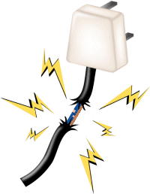
Electrical dangers
There are many dangers related to electricity:
faulty electrical equipment
damaged electrical equipment
exposed conductors
damaged insulation
worn electrical cables and cords trailing cables
proximity of cables
buried/hidden cables.

Slide 13
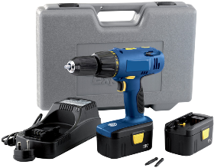
Battery powered supplies
Battery powered tools are now used widely in the building services industry. Using these has many advantages, including:
no trailing leads
voltage levels that mean there is no risk of electric shock
can be used where there are no mains supplies (assuming batteries are charged elsewhere)
greater mobility.

Slide 14
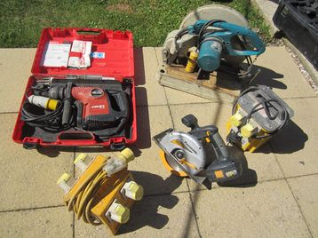
110 volt supplies
The use of reduced voltage power tools and equipment on site reduces the risk of electric shock.
The 110V supply is derived from a transformer.
The secondary is centre-tapped and connected to earth, i.e. touching either pole and earth results in a shock of 55V that in most cases will not cause harm.

Slide 15
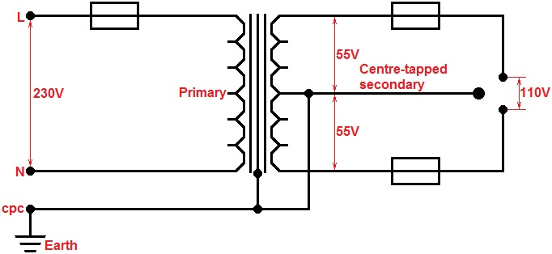
110 volt supplies
The transformer diagram is shown below:

Slide 16
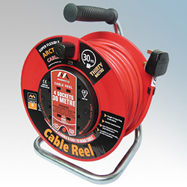
230 volt supplies
Most premises will have socket outlets at 230V only.
Real danger of electric shock with this level of voltage so RCD protection should be used, even indoors.
If not using battery powered tools, it is not unusual for engineers to plug in a 230/110V transformer and use 110V.
Most battery chargers for battery tools will need a 230V supply for charging.

Slide 17
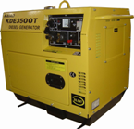
Generating sets
On sites where a mains supply is not available, generators will be used to power tools, for site lighting and plant.
Usually powered by petrol engines for smaller generators and diesel for larger ones.
Cables will radiate from the generator to feed equipment. Care must be taken not to create a hazard with these trailing leads.

Slide 18
Electrical hazards on construction sites
increased likelihood of damage to equipment
operative in better contact with earth and so more susceptible to electric shock
trailing leads.

Slide 19
Visual inspection of portable appliances
checking for a valid PAT label
inspection for general condition to include:
any damage to equipment casing
any damage to the flexible cord (lead)
any damage to the plug top and any obvious
connection issues, e.g. cord grip not properly used.

Slide 20
Unit 201: Health and safety in building services engineering
The End

